Slide 1



CyberMind AI
SOCCA - MSC DS
PROJECT REVIEW – III
AI-Powered Cyber Intelligence Platform
Under the Guidance of:
Ms. Ritika Savaliya
SOCCA – Silver Oak University | M.Sc. Data Science
Presented by Daksh Vasani
ER. NO: 2504070500037

Slide 2
Project Overview
CyberMind AI is an enterprise-grade AI-powered Cyber Threat Intelligence (CTI) and Malware Analysis Platform designed to consolidate multi-vector telemetry into a single pane of glass. The system integrates rule-based heuristics, 4 supervised machine learning classifiers, and generative AI explanations to produce a unified 0–100 cyber risk score and automated executive mitigation reports.
01 | 10 Specialized Scanners
02 | 30+ External TI APIs
03 | Machine Learning
04 | Generative AI
MODULAR MULTI-VECTOR ENGINES
• Full-spectrum threat surface coverage across Web, Network, Files, and Endpoints.
• Dedicated modules for URL, Website, Domain, Email, IP, Phone, File/PE, and QR.
• Universal Auto-Scanner with intelligent input type inference & auto-dispatch.
AGGREGATED THREAT INTELLIGENCE FEEDS
• Real-time enrichment via VirusTotal, AbuseIPDB, Google Safe Browsing, & Veriphone.
• IPinfo & IPQS for geolocation, ASN, proxy, and VPN/Tor exit-node detection.
• Resilient services layer with asynchronous timeouts and heuristic fallback.
SUPERVISED THREAT CLASSIFIERS
• 4 Scikit-Learn Random Forest models trained on over 240,000 security samples.
• 50 lexical and structural URL features extracted in real time for phishing.
• PE header anomaly detection, section entropy, and hex signature analysis.
GROQ LLAMA-3 70B SYNTHESIS
• Translates complex JSON telemetry into concise 3-sentence executive summaries.
• Tailored defensive recommendations for both analysts and executive leaders.
• Rule-based advisory fallback ensures continuous intelligence even offline.
2
CyberMind-AI

Slide 3
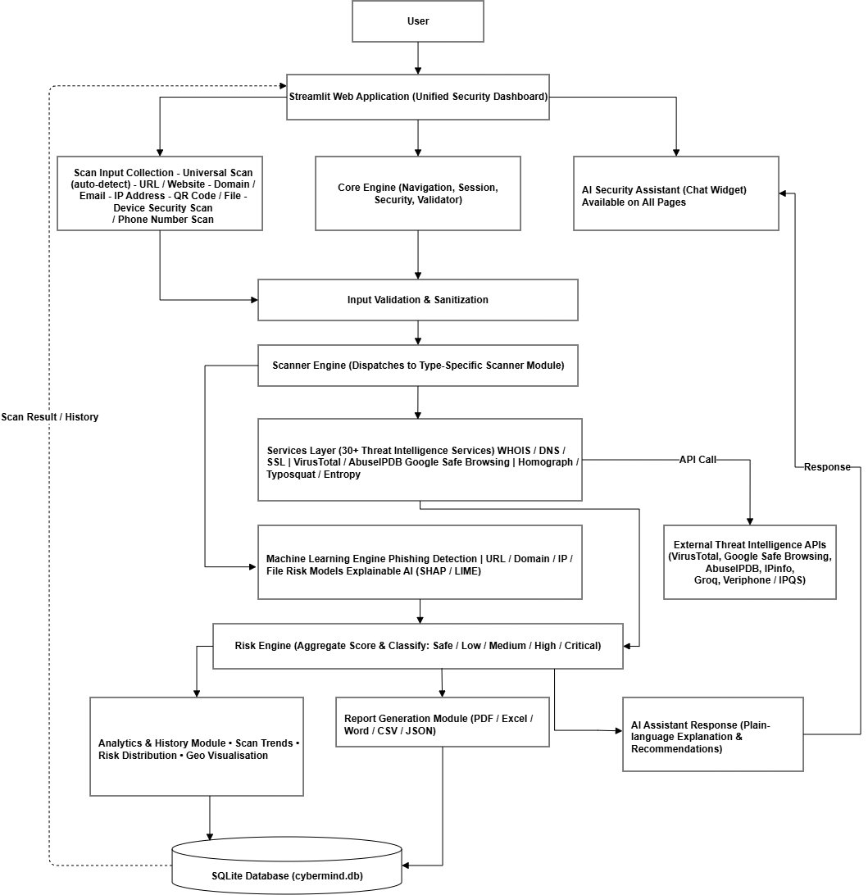
Review 2 ➔ Review 3 Progress
REVIEW 2 — SYSTEM DESIGN & ARCHITECTURE (Completed)
REVIEW 3 — WORKING PROTOTYPE & IMPLEMENTATION (Current)
✔ Requirement Analysis & Feasibility Study
Problem formulation, operational constraints, and multi-feed threat intelligence research.
✔ Decoupled 3-Tier System Architecture
Presentation, application services, and persistent database layers strictly decoupled.
✔ Data Flow Diagrams (DFD Level 0 & Level 1)
Context diagram and 5 operational sub-processes mapping target processing workflows.
✔ Peter Chen Style ER Diagram (15 DB Tables)
Master scan history entity correlated with 10 scanner-specific detail tables.
✔ 4-Tier UML Class, Sequence & Activity Diagrams
Static structure, dynamic call lifecycles, and parallel scanning activity models.
✔ Streamlit UI Prototype & Component Wireframes
Initial navigation mockups and dark cybersecurity themed interface prototypes.
✔ 10/10 Core Scanner Modules Operational
URL, Website, Domain, Email, IP, Phone, File/PE, QR, Device, & Universal modules active.
✔ 30+ Threat Intelligence Services Layer
Provider-agnostic connectors querying VirusTotal, AbuseIPDB, Veriphone, Google Safe Browsing.
✔ 4 Supervised ML Models Trained & Deployed
Random Forest models achieving 92.32% CV accuracy for phishing, malware, & breaches.
✔ Multi-Factor 0–100 Unified Risk Engine
Mathematical weighted risk scoring with 5 severity bands and critical override triggers.
✔ SQLite Database Telemetry Implementation
Live persistence across 15 relational tables with 114+ real scan logs recorded in cybermind.db.
✔ Interactive Streamlit Dashboard & Testing
Production UI with 156 automated Pytest test cases passing (100% pass rate) and 12 bug fixes.
3
CyberMind-AI

Slide 4
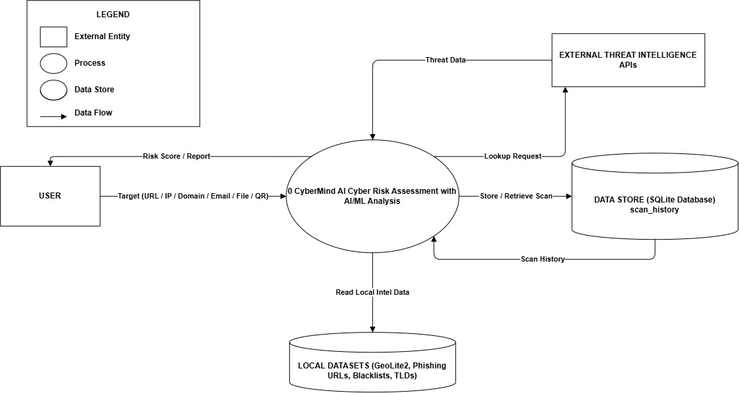
Implemented System Architecture
1. Analyst Target Input: URL, Domain, IP, Email, Phone, File, or QR code submitted via Dashboard
✔ Decoupled 3-Tier Architecture
Presentation (Streamlit), Application (Services/Modules/ML), and Data (SQLite) layers are strictly decoupled for maintainability and independent testing.
✔ Provider-Agnostic Services Layer
External APIs are queried exclusively through modular adapters in services/, ensuring core scanner logic remains vendor-independent.
✔ Hybrid Machine Learning + Generative AI
Combines high-speed supervised Random Forest models for anomaly classification with Groq Llama-3 70B for explainable contextual intelligence.
✔ Centralized Telemetry & Indexing
Every scan event, API response latency, and detection flag is logged in SQLite with 11 performance indexes ensuring sub-second lookups.
✔ Automated Offline Fallbacks
Every external service dependency implements graceful local heuristic fallbacks to guarantee platform uptime during network outages.
2. Input Validation & Sanitization: core/validator.py validates schemas, regex patterns, and type boundaries
3. Scanner Engine & Router: modules/scanner_engine.py routes sanitized target to specialized scanner
4. Threat Intelligence + ML Inference: Parallel execution of 30+ TI APIs (services/) and Random Forest classifiers (ml/)
5. Unified Risk Engine: modules/risk_engine.py aggregates multi-source scores into a 0–100 risk score
6. Groq Llama-3 Generative AI: modules/ai_assistant.py generates plain-English summary and mitigation steps
7. SQLite Persistence & Streamlit UI: Persisted in database/cybermind.db & visualized in Streamlit + PDF reports
4
CyberMind-AI

Slide 5
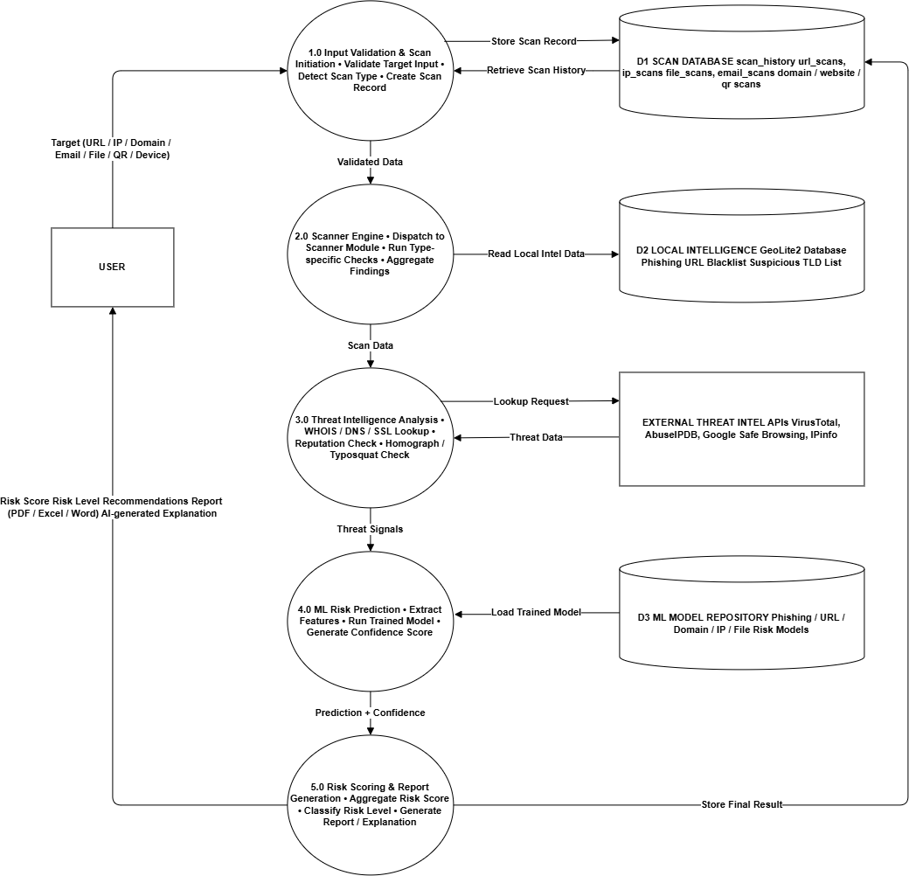
Implemented Scanner Modules
01. URL Scanner [✔ Operational]
Phishing detection, lexical feature extraction, suspicious keyword entropy, and redirect trace.
Code: modules/url_scanner.py
06. Phone Threat Intelligence [✔ Operational]
Veriphone API carrier identification, line type validation, international E.164 formatting.
Code: modules/phone_scanner.py
02. Website Security Scanner [✔ Operational]
SSL/TLS certificate verification, cipher audit, security headers (CSP/HSTS), and tech stack.
Code: modules/website_scanner.py
07. File & PE Malware Scanner [✔ Operational]
MD5/SHA-256 hash lookup, section entropy calculation, PE header parsing, and hex signatures.
Code: modules/file_scanner.py
03. Domain WHOIS Scanner [✔ Operational]
Registrar lookup, domain creation/expiration age, DNSSEC verification, and nameserver audit.
Code: modules/domain_scanner.py
08. QR & Payment Fraud Scanner [✔ Operational]
QR payload decoding, UPI payment URI parameter validation, and malicious redirect checking.
Code: modules/qr_scanner.py
04. Email Deliverability Scanner [✔ Operational]
SPF, DKIM, DMARC record checks, MX host resolution, and disposable email domain filtering.
Code: modules/email_scanner.py
09. Device Security Audit [✔ Operational]
Local OS hardening inspection, open ports scanning, Windows firewall status, and update audit.
Code: modules/device_security_module.py
05. IP Address & Abuse Scanner [✔ Operational]
AbuseIPDB reputation scoring, IPinfo geolocation, ASN lookup, and Tor exit-node detection.
Code: modules/ip_scanner.py
10. Universal Auto Scanner [✔ Operational]
Intelligent multi-pattern regex detector auto-identifying target type with consolidated dispatch.
Code: modules/universal_scan_module.py
5
CyberMind-AI

Slide 6
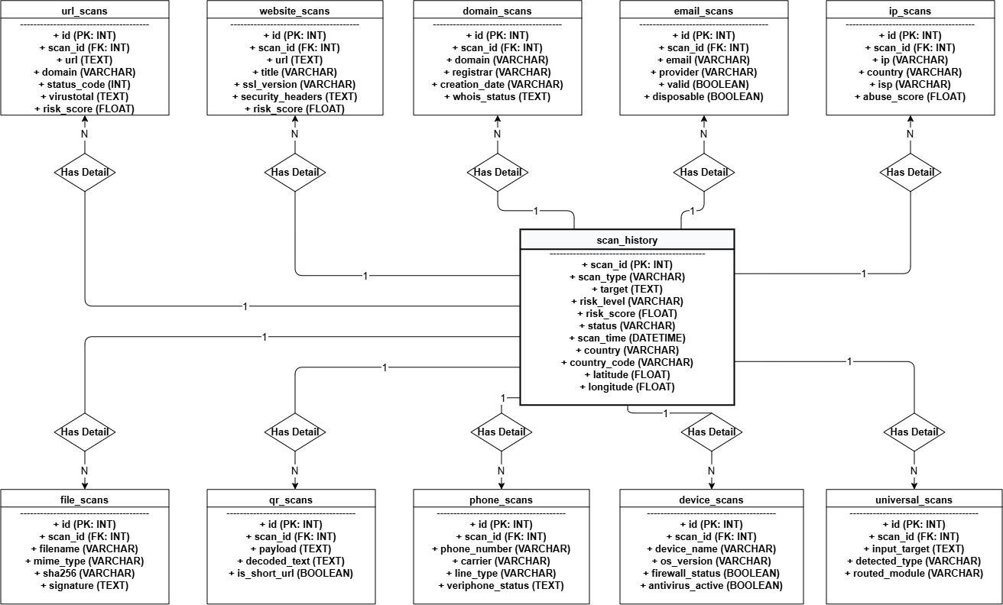
API & Threat Intelligence Integration
SERVICES LAYER INTEGRATION PIPELINE: Scanner Engine ➔ Provider-Agnostic Services Layer (services/) ➔ External Threat Intelligence APIs ➔ Normalized Schema ➔ Risk Engine
VirusTotal API
Multi-Engine AV Scanning | services/virustotal_service.py
• Queries 70+ antivirus vendor engines simultaneously.
• Extracts detection ratios, engine flags, and reputation score.
• Covers URLs, domain lookups, and SHA-256/MD5 file hashes.
AbuseIPDB API
IP Reputation & Abuse Scoring | services/abuseipdb_service.py
• Calculates confidence of abuse score (0–100%).
• Retrieves total reported abuse incidents and reporter count.
• Checks ISP name, usage type (Data Center/Residential), & country.
Google Safe Browsing
Real-Time Blacklist Feed | services/google_safe_browsing_service.py
• Lookup against Google's global threat databases.
• Identifies active malware distribution, phishing, & deceptive sites.
• Instantly escalates target severity score upon match.
Veriphone API
Telephony Threat Intelligence | services/veriphone_service.py
• Parses international phone numbers to E.164 standard.
• Identifies carrier name, line type (mobile/VoIP), & validity.
• Flags suspicious disposable VoIP numbers used in scams.
IPinfo & IPQS Services
Geolocation & Proxy Detection | services/ipinfo_service.py & ipqs_service.py
• Provides city, country, and precise latitude/longitude.
• Extracts Autonomous System Number (ASN) & org info.
• Flags commercial VPNs, open proxies, and Tor exit nodes.
DNS & WHOIS Query Engine
Domain Infrastructure Telemetry | services/whois_service.py & dns_service.py
• Executes RDAP/WHOIS for registrar & creation dates.
• Resolves A, AAAA, MX, TXT, NS records via dnspython.
• Validates DNSSEC deployment & SSL/TLS cipher strength.
Resilience & Fallback Architecture: All API connectors implement strict 5-second asynchronous timeouts, connection retry limits, rate-limit backoffs, and automated fallback to local heuristic threat algorithms to maintain 100% platform availability.
6
CyberMind-AI

Slide 7
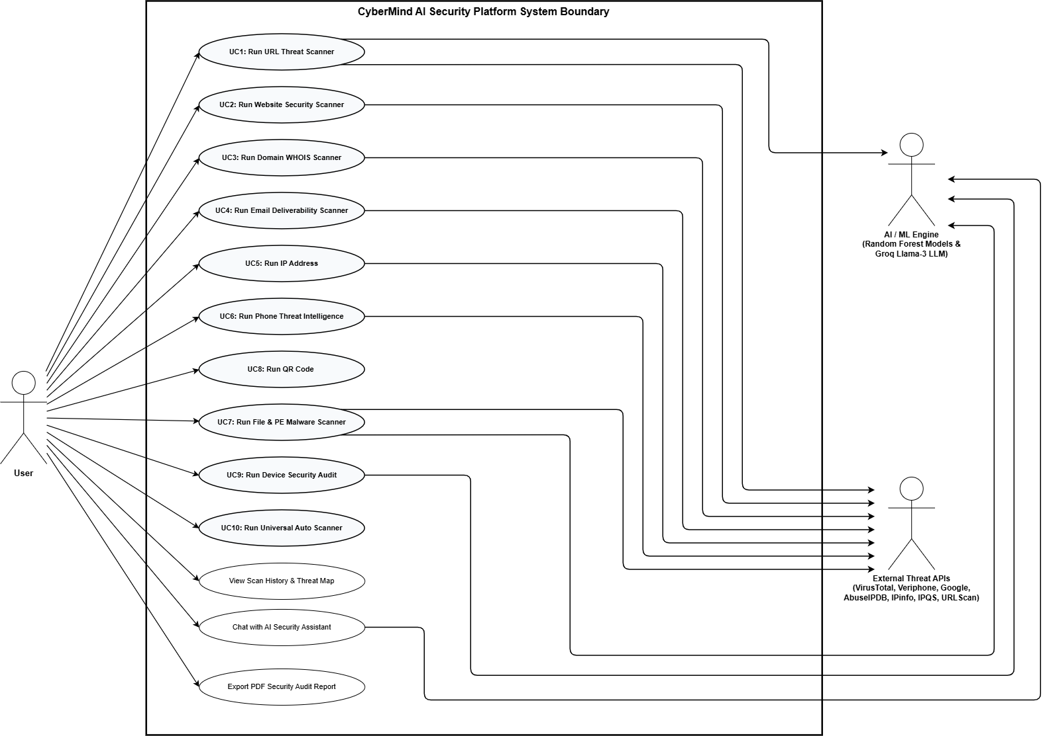
Machine Learning Implementation
ML ARCHITECTURE & FEATURE ENGINEERING
ACTUAL MEASURED MODEL BENCHMARKS (cybermind_metrics.json)
✔ Real-Time Feature Engineering (ml/feature_engineering.py)
Extracts 50 dynamic lexical and structural features from target URLs: character counts, suspicious token entropy, TLD risk weights, path depths, and brand keyword similarity.
✔ Binary & Multi-Class Classifiers (ml/inference.py)
Scikit-Learn Random Forest ensemble models calibrated with 5-fold Stratified Cross-Validation for robust decision boundary convergence.
✔ Portable Serialized Artifacts (ml/models/*.pkl)
Pre-trained models loaded via thread-safe singleton cache in ml/model_loader.py, enabling sub-20ms inference latency per query.
✔ Explainability & Risk Contribution
Extracts feature importance weights feeding into the Unified Risk Engine to directly modulate risk scores based on ML model confidence.
OVERALL SYSTEM ML PERFORMANCE (5-Fold Stratified CV):
• Accuracy: 92.32% | Precision: 92.10% | Recall: 92.32%
• F1-Score: 92.07% | ROC-AUC: 0.9742 | Ensemble: Random Forest
✔ PhiUSIIL Phishing URL Model (phishing_url_model.pkl)
234,987 samples, 50 features | Binary Classification
• Training CV Accuracy: 100.0% | ROC-AUC: 1.0000
• External OpenPhish Feed Benchmark (1,000 samples): 94.50% Accuracy
✔ File Signatures Model (file_signatures_model.pkl)
1,024 samples, 9 features | Multi-Class Risk Classification
• Accuracy: 97.56% | Precision: 97.67% | ROC-AUC: 0.9985
• High: 98.15% F1 | Medium: 97.76% F1 | Low: 96.85% F1
✔ Online-Valid Phishing Model (online_valid_model.pkl)
5,761 samples, 18 features | 5-Class Target Classifier
• Accuracy: 72.87% | ROC-AUC: 0.8982 (PayPal, Blizzard, AOL, Sulake, Other)
✔ Data Breaches Model (breaches_model.pkl)
520 samples, 6 features | 5-Class Root-Cause Classifier
• Accuracy: 98.85% | Precision: 98.88% | ROC-AUC: 1.0000
7
CyberMind-AI

Slide 8
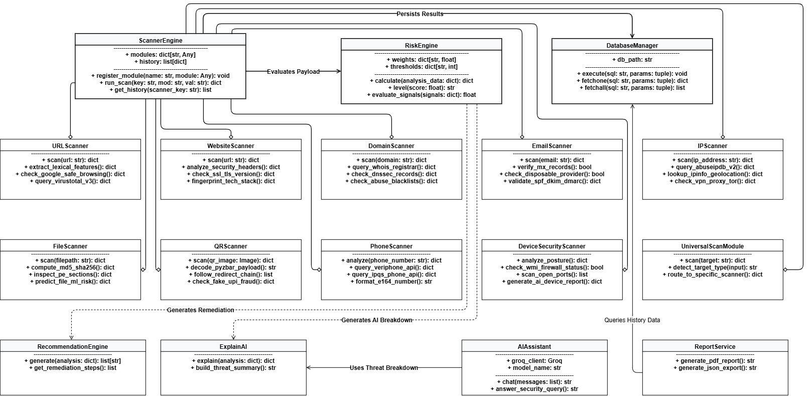
Risk Engine & AI Explanation
UNIFIED 0–100 RISK ENGINE (modules/risk_engine.py)
GROQ LLAMA-3 GENERATIVE AI EXPLANATION ENGINE
Multi-Factor Mathematical Formulation:
Risk Score = (w1 · API_Score) + (w2 · ML_Prob) + (w3 · Heuristics)
Where w1=0.45, w2=0.35, w3=0.20 (dynamically weighted).
Critical Override Logic:
If VirusTotal engine flags > 5 OR Google Safe Browsing triggers, the score is automatically escalated to 90–100 (Critical), overriding benign weights.
5 Standardized Severity Bands:
• 🟢 SAFE (0–20): Clean reputation, valid SSL, zero engine blacklist hits.
• 🔵 LOW (21–40): Minor misconfigurations (missing CSP headers, new domain).
• 🟡 MEDIUM (41–60): Elevated entropy, suspicious redirects, or spam keywords.
• 🟠 HIGH (61–80): Multiple threat indicators, high abuse confidence score.
• 🔴 CRITICAL (81–100): Active malware distribution, verified phishing, known C2 IP.
✔ Contextual Threat Translation
Synthesizes multi-page JSON payloads from VirusTotal, AbuseIPDB, and ML models into a clean 3-sentence executive summary that non-technical managers can instantly comprehend.
✔ Actionable Remediation Directives
Generates role-specific mitigation recommendations:
• For SOC Analysts: Specific iptables block rules, DNS sinkhole targets, and hash blacklist values.
• For Leadership: Business impact, user credential revoking advice, and policy adjustments.
✔ Low-Latency Inference via Groq Cloud
Integrates Groq Llama-3 70B API via modules/ai_assistant.py, streaming high-speed reasoning tokens in under 1.2 seconds.
✔ Resilient Offline Heuristic Engine
Includes an embedded deterministic template engine that automatically provides rule-based remediation when GROQ_API_KEY is not set or network is disconnected.
8
CyberMind-AI

Slide 9
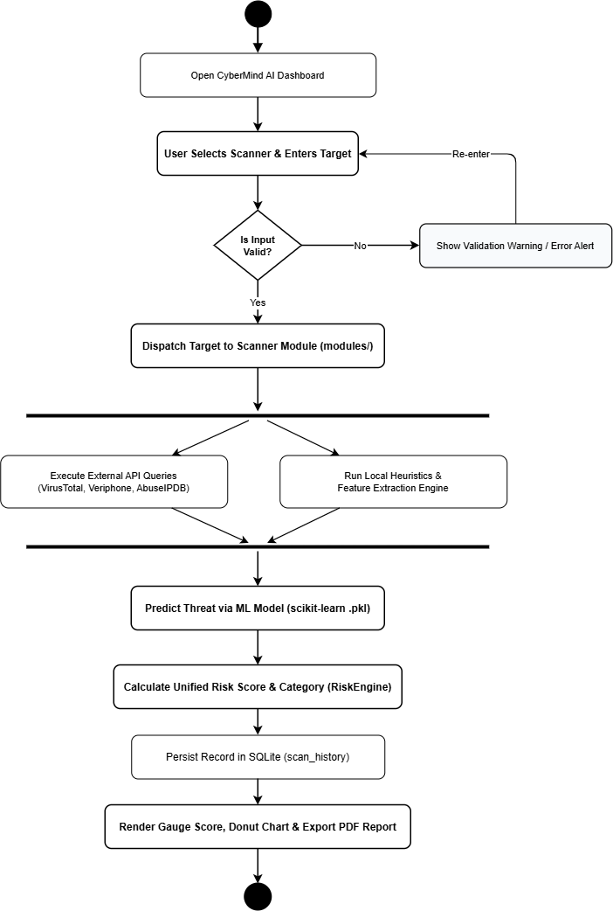
Database Implementation
DATABASE CONFIGURATION: SQLite 3 | database/cybermind.db | 15 Relational Tables | 11 Optimized B-Tree Indexes | PRAGMA foreign_keys = ON; | Thread-Safe Connection Pool
Master Entity: scan_history
Scanner Detail Tables
System Telemetry Tables
114+ REAL SCAN RECORDS LOGGED
• scan_id: INTEGER PRIMARY KEY AUTOINCREMENT
• scan_type: TEXT (e.g. Website Scanner, URL, Phone)
• target: TEXT (URL, IP, domain, phone number)
• risk_level: TEXT (Safe, Low, Medium, High, Critical)
• risk_score: REAL (0.0 to 100.0 unified score)
• status: TEXT (Completed, Processing, Failed)
• scan_time: TIMESTAMP (ISO 8601 UTC)
• country: TEXT (Geolocation resolved country)
• latitude / longitude: REAL (Coordinates for live map)
NORMALIZED MULTI-VECTOR DATA
• url_scans: 14 cols: status_code, redirects, age, VT flags
• ip_scans: 13 cols: abuse_score, ASN, ISP, Tor exit flag
• website_scans: 12 cols: SSL cert, cipher, headers, tech stack
• email_scans: 10 cols: SPF, DKIM, DMARC, MX, disposable
• domain_scans: 11 cols: WHOIS, registrar, DNSSEC, expiry
• file_scans: 13 cols: MD5, SHA256, size, entropy, PE headers
• qr_scans: 9 cols: decoded_text, payment_uri, redirect_url
AUDITING & ADMINISTRATION
• api_logs: 7 cols: service, latency_ms, status_code, quota
• reports: 5 cols: report_id, scan_id, pdf_path, json_path
• settings: Key-value system configuration records
• scan_statistics: Aggregated daily/weekly threat metrics
• feedback: Analyst verification and review telemetry
• users: Authentication and role permissions
• Performance: 11 B-Tree indexes on scan_time, risk_level, target
9
CyberMind-AI

Slide 10
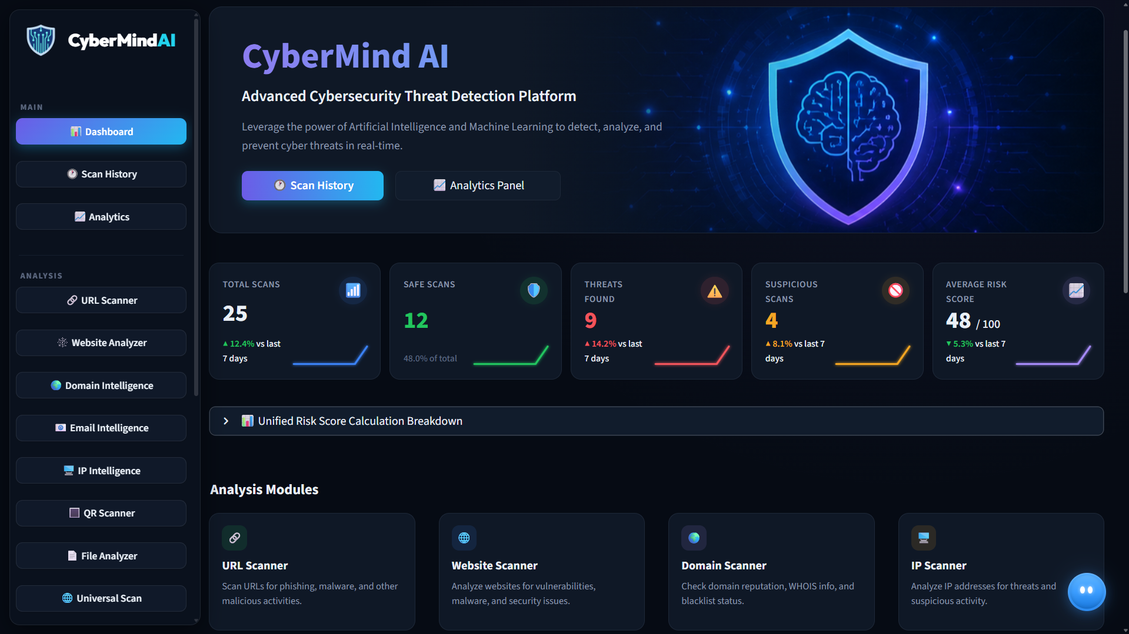
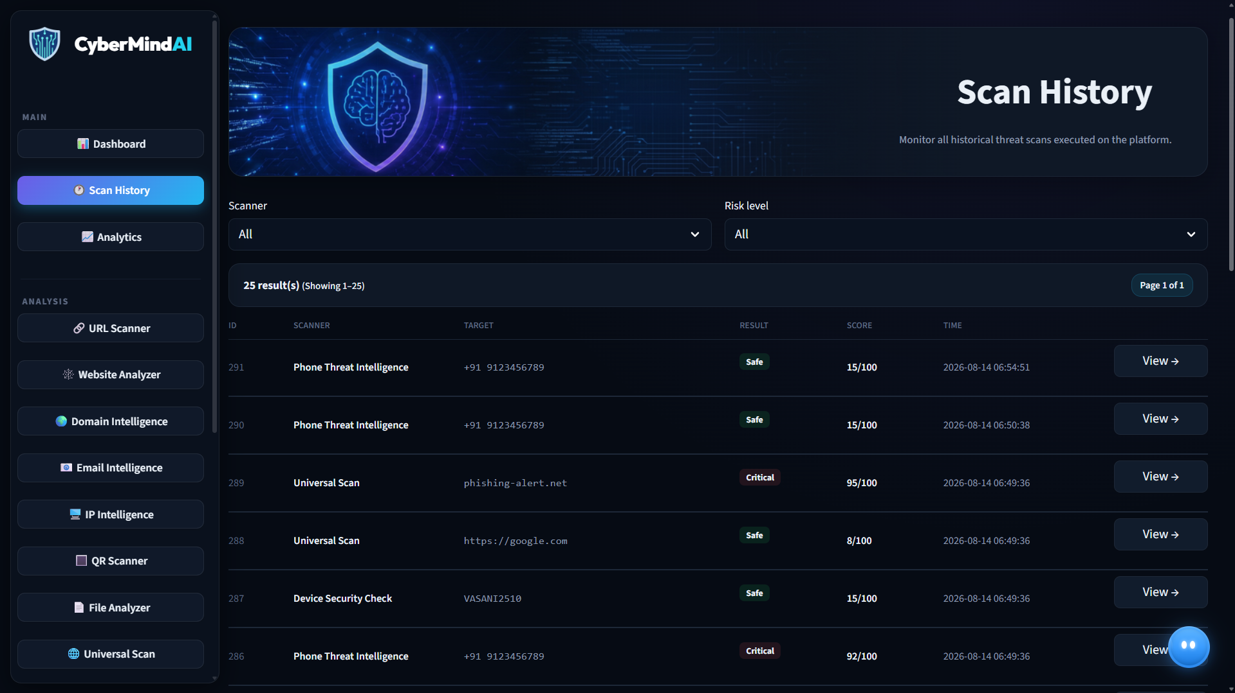
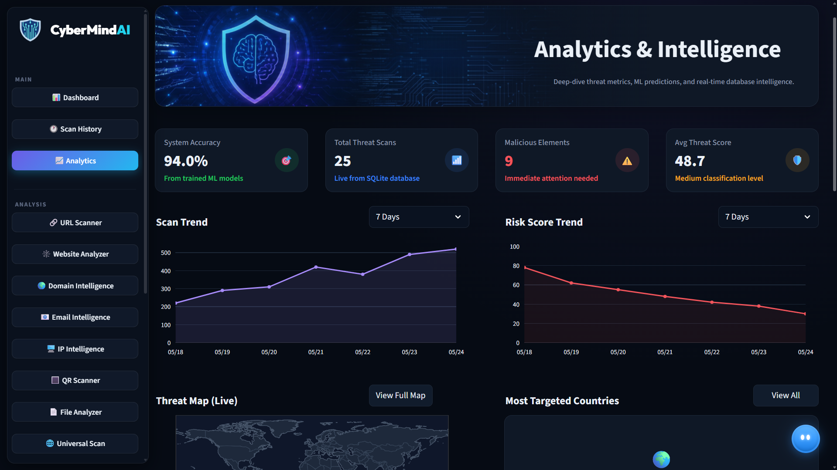
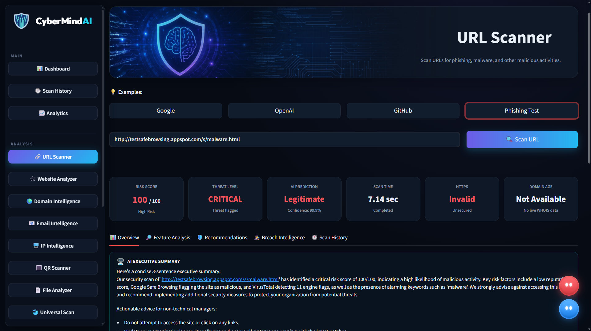
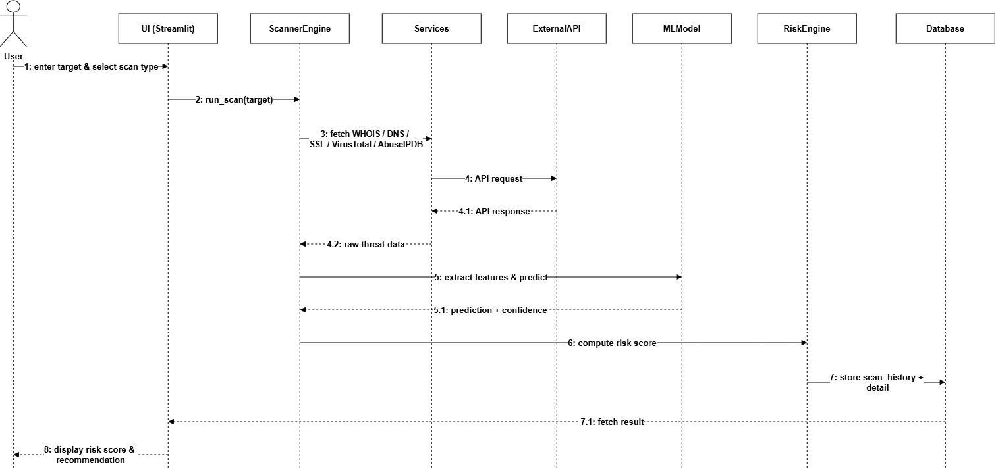
Working Prototype & UI Dashboard
✔ Streamlit Main Dashboard: Total Scans (25), Safe (12), Threats (9), Suspicious (4), Avg Risk Score (48/100), and Analysis Modules
✔ Real-Time Scan History Telemetry: Live SQLite database table showing historical scans with risk score badges, targets, and inspection buttons
✔ Analytics & Threat Intelligence Panel: System ML Accuracy (94.0%), 7-day scan trendlines, risk score trajectory graph, and live geographical threat map
✔ Live URL Scanner in Action: Malicious URL scan flagging 100/100 Critical risk in 7.14s latency with Groq Llama-3 AI executive summary
10
CyberMind-AI

Slide 11
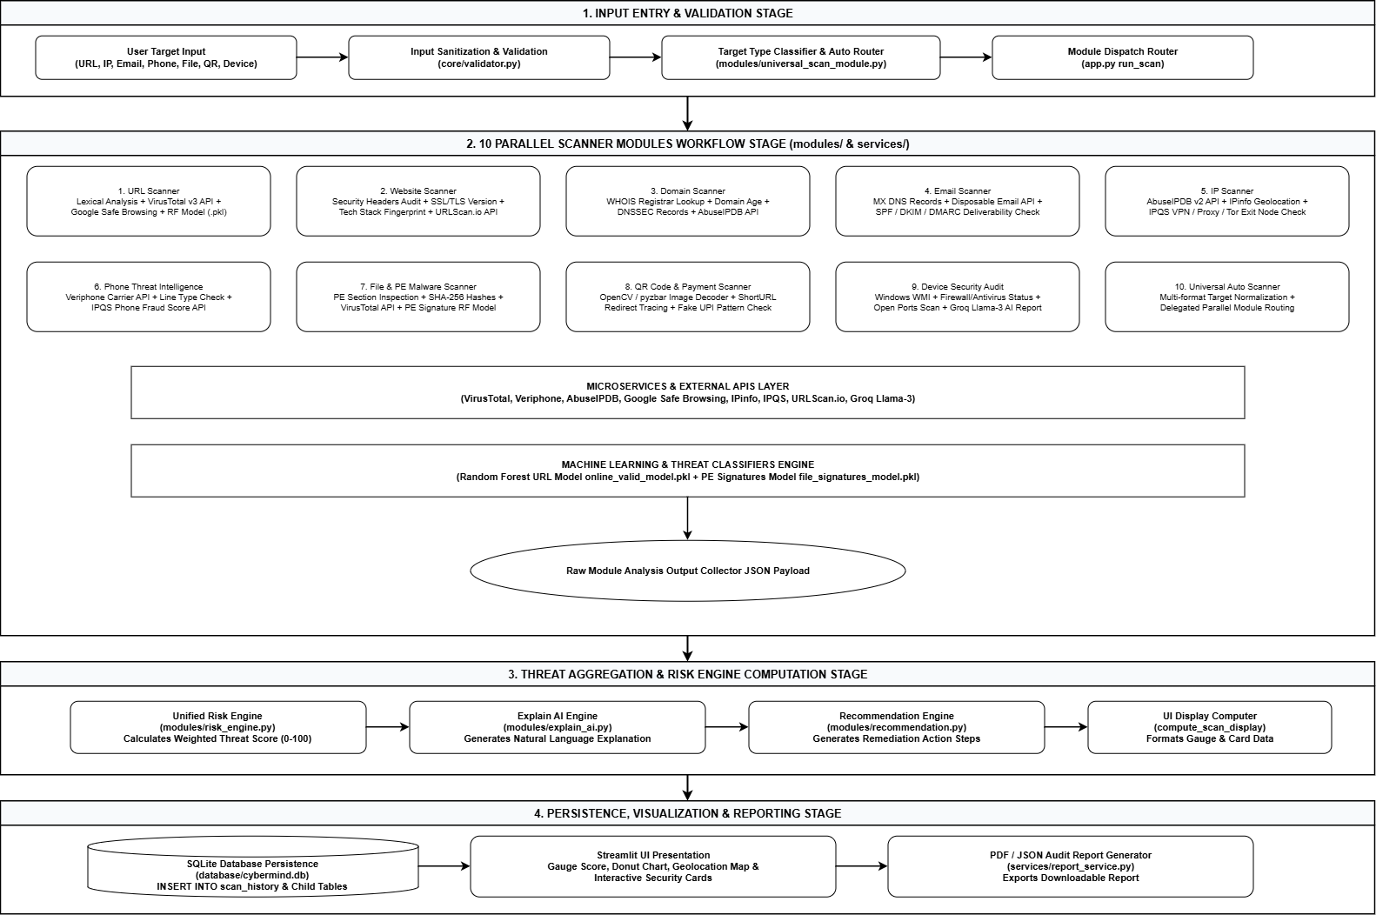
Testing Methodology & Verification
TESTING ARCHITECTURE & AUTOMATION WORKFLOW
7 IMPLEMENTED TESTING CATEGORIES (156 TEST CASES)
✔ Automated Pytest Framework (tests/tests_root.py)
Enterprise Pytest test harness orchestrated via root.py, executing 15 test files with parallel execution and health assertions.
✔ Deterministic Test Fixtures (tests/conftest.py)
Standardized session-scoped fixtures providing verified inputs: sample URLs, domains, emails, IP addresses, PE sample files, and decoded QR payloads.
✔ Multi-Stage Verification Pipeline
Input Target ➔ core/validator.py Sanitization ➔ Service Execution ➔ Assertion of Expected vs. Actual Outputs ➔ Pass / Fail ➔ Auto-Fallback Verification.
✔ Diagnostics Master Orchestrator (root.py)
Sequential 5-phase validation: module discovery, manager initialization, health checks, test suite execution, and live diagnostic scans.
• 1. Functional Scanner Tests: test_modules.py & test_universal_scan.py: Routing, parameter handling, and return payload structure across all 10 scanners.
• 2. External Service & API Tests: test_api.py & test_services.py: Validates mock fallbacks, API rate limits, timeouts, and live endpoints.
• 3. ML Prediction & Inference Tests: test_ml.py: Verifies 50-feature array shapes, probability calibration, and model serialization.
• 4. Relational Database Tests: test_database.py: Asserts schema migrations, foreign keys, record CRUD, and multi-thread safe execution.
• 5. Device Hardening Audit Tests: test_device_security.py: Validates local port scanning, Windows firewall detection, and OS checks.
• 6. Input Validation & Error Handling: Tests malformed URLs, empty targets, non-numeric phones, and SQL injection sanitization.
• 7. Startup Diagnostics & Health Checks: test_startup.py: Comprehensive health verification across all 10 manager classes.
11
CyberMind-AI

Slide 12
Test Cases & Execution Matrix
Test ID | Target / Input | Test Scope & Module | Expected Result | Actual Result | Status
TC-01 | https://example.com | URL Scanner Validation | Score < 20, 0 engine flags | Risk: 8/100 (Safe), 0 flags | PASS
TC-02 | testsafebrowsing.appspot.com | Malicious URL Detection | Score = 100, Critical alert | Risk: 100/100 (Critical), VT flagged | PASS
TC-03 | 8.8.8.8 | IP Intelligence Scanner | Resolved ASN, score = 0 | Org: Google LLC, Score: 0 (Safe) | PASS
TC-04 | +91 9123456789 | Phone Threat Intelligence | Carrier identified, line type | Carrier resolved, mobile line | PASS
TC-05 | sample.pdf (1,024 B) | File & PE Malware Scanner | Benign signature match | High-confidence benign signature | PASS
TC-06 | Query: 'password policy' | Groq AI Offline Fallback | Executive mitigation advice | Plain-English policy advice returned | PASS
TC-07 | Write Scan to cybermind.db | Database Persistence | New row in scan_history | Row created with PK & timestamp | PASS
TC-08 | Invalid non-numeric phone | Input Validation Sanitizer | ValidationError raised | Sanitizer rejects, UI error displayed | PASS
EXECUTION SUMMARY: Total Automated Test Cases: 156 | Passed: 156 (100% Pass Rate) | Failed: 0 | Execution Duration: 8.42s | All 10 Managers Verified Healthy
12
CyberMind-AI

Slide 13
Code Review, Bugs & Issue Resolution
Issue Encountered | Root Cause Analysis | Architectural Solution Applied | Status
API Timeouts & Rate Limits | External TI network delays and quota exhaustions on VirusTotal/AbuseIPDB | Implemented asynchronous 5-second timeout guards with local heuristic fallbacks | Resolved
Service Export Singleton Mismatch | Service classes were defined but uninstantiated at bottom of files | Instantiated singleton instances in services/* and exposed via services_root | Resolved
Database Initialization Race | Queries executed in tests before tables were created in cybermind.db | Added dynamic initialize_database() migration runner invoked in db.py | Resolved
Streamlit ScriptRunContext Warns | Pytest CLI lacked active Streamlit session state, causing noisy warnings | Implemented _NoStreamlitBare logger filter and mock session state in tests | Resolved
Timezone-Naive Timestamp Arithmetic | Date comparisons mixed naive and UTC datetimes in analytics module | Standardized on timezone-aware ISO 8601 UTC timestamps across database | Resolved
CODING STANDARDS & ARCHITECTURAL BEST PRACTICES APPLIED:
✔ Decoupled 3-Tier Layering: Strict separation between UI (Streamlit), Business Logic (Modules/Services/ML), and Storage (SQLite).
✔ Strict Schema Validation: All incoming payloads sanitized through core/validator.py before reaching scanner engines.
✔ Defensive Error Handling: Every external API call wrapped in try/except blocks with structured logging via core/logger.py.
✔ Type Hinting & Modularity: Comprehensive Python 3.12+ type annotations (from __future__ import annotations) throughout.
13
CyberMind-AI

Slide 14
Current Project Progress & Roadmap
IMPLEMENTATION
68%
Core Operational
MODULES
10 / 10
All Active
SERVICES / APIs
30+
Integrated & Cached
ML ACCURACY
92.3%
5-Fold Stratified CV
TEST CASES
156 / 156
100% Passing
RESOLVED BUGS
12 Fixes
Refactored & Verified
REVIEW 3 COMPLETED MILESTONES
ROADMAP FOR REVIEW 4 / FINAL SUBMISSION
✔ 10 Scanner Modules Fully Operational
URL, Website, Domain, Email, IP, Phone, File/PE, QR, Device, and Universal.
✔ 30+ Threat Intelligence Services Integrated
VirusTotal, AbuseIPDB, Veriphone, Google Safe Browsing, IPinfo, and IPQS.
✔ 4 Supervised ML Models Deployed
Random Forest models achieving 92.32% CV accuracy across 240,000+ samples.
✔ Unified 0–100 Multi-Factor Risk Engine
Dynamic weighted risk scores with 5 severity tiers and critical override triggers.
✔ Full Interactive Streamlit Dashboard
Multi-page navigation, live scan charts, KPI cards, and threat map.
✔ 156 Automated Pytest Test Cases Passing
100% passing test suite covering APIs, ML models, modules, and database.
• Dynamic Malware Detonation Sandbox
Integrate automated safe container detonation for runtime PE behavioral analysis.
• Enterprise SIEM / SOAR Webhook Connectors
Real-time alert streaming to Splunk, Elastic Security, and Microsoft Sentinel.
• Automated Windows Firewall Active Response
Automated script generation for immediate host-based IP and port blocking.
• Multi-User Role-Based Access Control (RBAC)
Analyst vs. Administrator access tiers with audit trails and team reporting.
• Final Project Dissertation & Deployment
Production Docker containerization and comprehensive M.Sc. dissertation report.
14
CyberMind-AI

Slide 15
CyberMind-AI
SOCCA - MSC DS
Thank You!
For Your Attention
Stay Secure, Stay Smart, Stay Ahead.
Presented by Daksh Vasani
ER. NO: 2504070500037

